Slide 1

Predicting flight delays with machine learning
Lana R
Project 4
Data Analytics Bootcamp

Slide 2

Introduction
Flying can be an exciting but frustrating experience
Flight issues may include:
Diversions: low rate of occurrence
Cancellations: extreme circumstances
Delays: common year-round
Wide-ranging effects for carriers and passengers
Common causes of delays:
Security
Maintenance
Poor weather conditions

Slide 3


Let’s go already!
Can we predict if a domestic flight will be delayed?
Definition:
According to the FAA, a flight is considered delayed if it has not taken off within 15 minutes of its scheduled departure time
Dataset obtained from the Bureau of Transport Statistics
Flight records ranged from September 2022 – August 2023
Over 6.7 million entries

Slide 4

Data processing
Cleaning:
Dropped columns lacking clear value
NAN entries removed
Selective data remapping
Filtered airports
Avoiding dummy variable traps
Prediction modelling:
Logistical Regression
Followed by Random OverSampling
Random Forest
Followed by Best Estimator

Slide 5
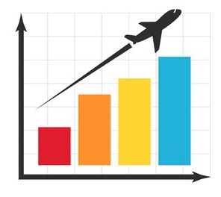
Initial Assessment
Tableau demo

Slide 6

Observations
Most delayed origins/destinations
Top airports similar on both lists
Busier locations will have a higher delay rate
Most delayed airlines
Southwest is top serving and top delayed
Potential anomaly compared with other sources
Across the year:
Peaks in June/July, and December
Across the month:
Very slight trendline decrease as month progresses
Peaks dates: 11th, 16th, 23rd, 26th
Significant decrease in delays on 31st correlates with fewer scheduled flights
Across the week:
Fewest delays observed Tuesdays, Wednesdays, and Saturdays

Slide 7

Model Comparison
Logistical Regression
Suitable only for binary classification problems
Assumes linear relationships between the independent/dependent variables
Prone to overfitting
Prone to biased predictions for imbalanced datasets
Random Forest
Suitable for both classification and regression problems
Handles missing values, outliers, and non-linear relationships well
Handles high-dimensional data well
Time-consuming to train

Slide 8
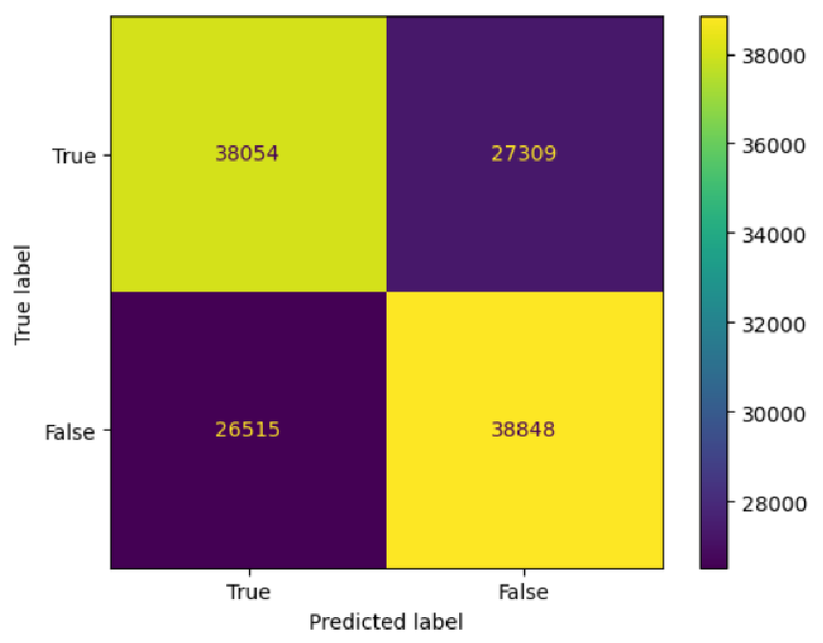
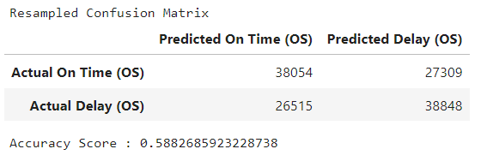
Predictions: Logistical Regression
Memory limitations & dataset size
Initial accuracy: 50%
Extreme imbalance in y values
On-Time: 87185
Delayed: 25917
Random OverSampler raised the accuracy to 59%

Slide 9
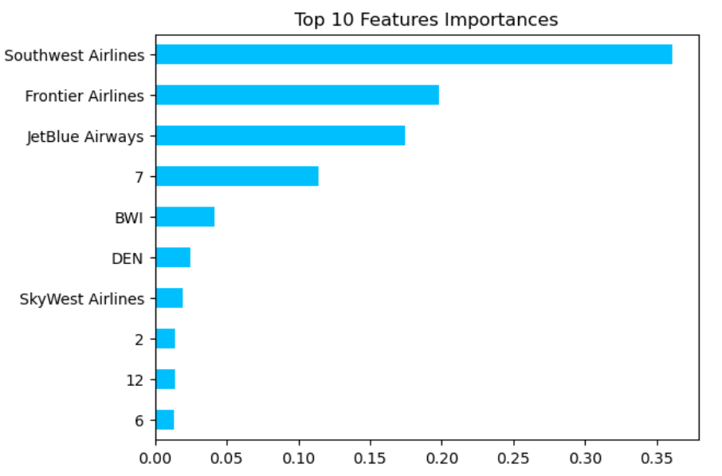
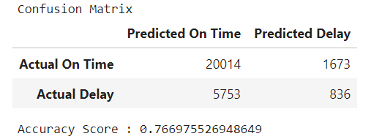
Predictions: Random Forest
Random Forest yielded much better starting results: 74% accuracy
Top 10 Feature focused on weekdays, then dates
Best Estimator was indeed the best model: 77% accuracy
Top 10 Features focused on multiple items: airlines, locations, dates

Slide 10
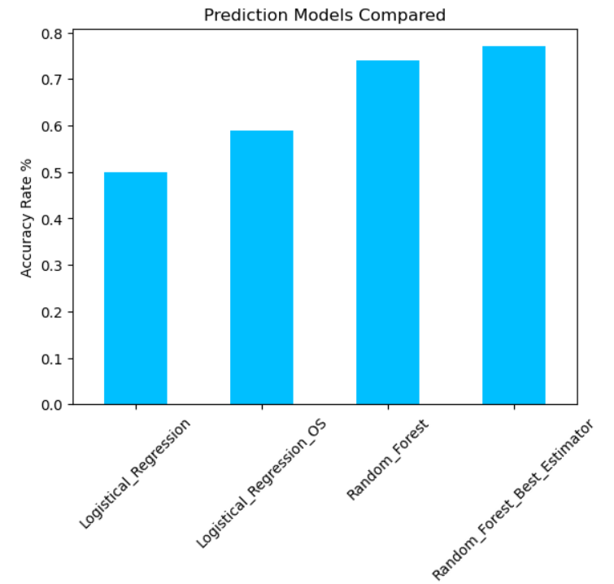
So what?
Flight delays CAN be predicted
Clear winners: Random Forest, Best Estimator
Additional model adjustments and larger datasets may improve outcomes

Slide 11
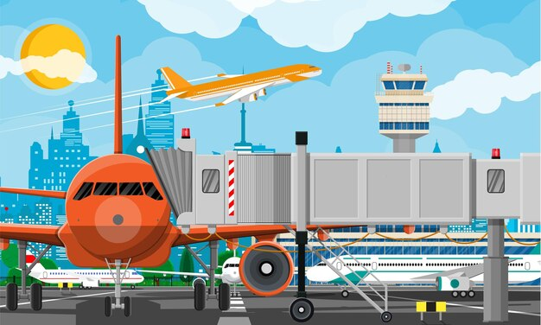
next steps
Locating detailed time and reliable delay reason indicators can help further refine the model and results
Memory limitations prevent processing a larger representative sample
Applying additional technologies can make the model more robust and interactive

Slide 12


The bright side
Airlines and airports aren’t responsible for all delays
Government shutdowns, security threats, other unusual/unexpected events
Companies learn and make changes based on their findings
Southwest is implementing technological upgrades and de-icing improvements
Be prepared: supplement predictions with real-time monitoring, and a book
Flight delays often result in safer outcomes- better late than never!

Slide 13



Slide 14

References
Office Hours & Class Exercises
Bureau of Transportation Statistics
www.npr.org/2023/11/09/1211064462/southwest-airlines-flight-cancellations-holiday-travel
en.wikipedia.org/wiki/Flight_cancellation_and_delay#:~:text=A%20flight%20delay%20occurs%20when,later%20than%20its%20scheduled%20time.
www.aspm.faa.gov/aspmhelp/index/Types_of_Delay.html
github.com/maptv/AnomalyDetection
www.w3schools.com/python/python_ml_confusion_matrix.asp
https://towardsdatascience.com/mastering-random-forests-a-comprehensive-guide-51307c129cb1
https://www.geeksforgeeks.org/logistic-regression-vs-random-forest-classifier/
www.vantage-ai.com/en/blog/4-strategies-how-to-deal-with-large-datasets-in-pandas#:~:text=Another%20way%20to%20drastically%20reduce,that%20refer%20to%20these%20strings
www.stackoverflow.com/questions/38300152/how-to-significantly-reduce-size-of-dataset-say-csv-to-analyse-in-pandas
www.learndatasci.com/glossary/dummy-variable-trap/
www.geeksforgeeks.org/using-dictionary-to-remap-values-in-pandas-dataframe-columns/#
www.stackoverflow.com/questions/29576430/shuffle-dataframe-rows
https://www.lendingtree.com/credit-cards/study/airlines-on-time-arrivals/

